Slide 1
CSE115 PROJECT PRESENTATION
THE PHONEBOOK BY:
Tausif Mushtaque
Mirza Farhan
Farhan Labib

Slide 2
Content:
Library Function:<stdio.h>, <string.h>
User Defined Functions
Recursion
File I/O processing
Struct

Slide 3
Library functions:
We used the standard library function “<stdio.h>” which stands for standard input and output. It has information related to input and output
We used library function “<string.h>” to work with strings in this project

Slide 4
User defined functions:
boot();
Menu();
Login();
Registration();
AddContact();
Search();
DeleteAll();
List All();

Slide 5

Boot()

Slide 6
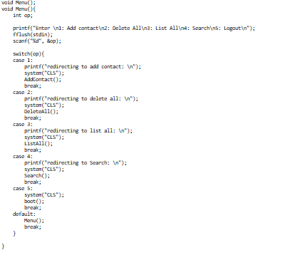
Menu();

Slide 7
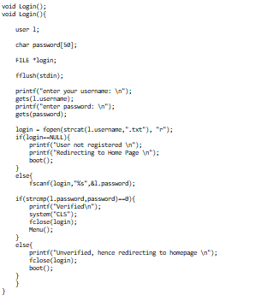
Login();

Slide 8
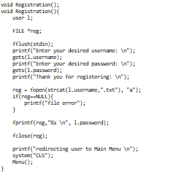
Registration();

Slide 9
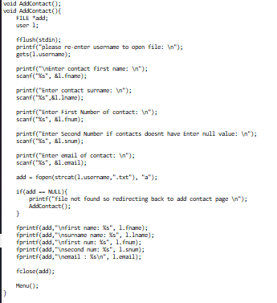
AddContact();

Slide 10
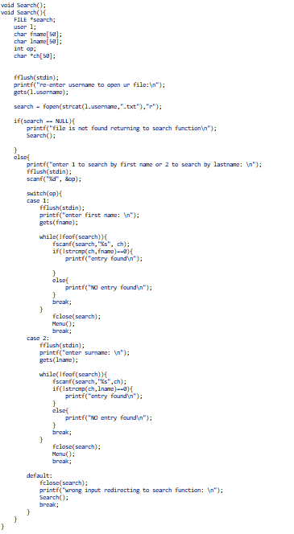
Search();

Slide 11
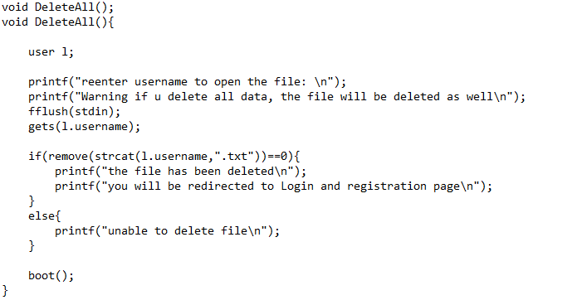
DeleteAll();

Slide 12
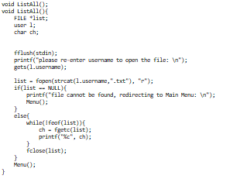
ListAll();

Slide 13
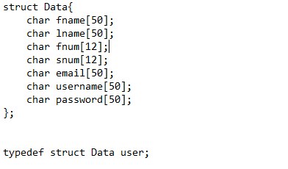
Struct();

